Slide 1



What is my ‘climate story’?
What is my ‘climate story’?
Success Criteria - I can:
- Identify factors that have affected my view of the environment.
- Reflect on how I can tell my own story in relation to Climate Change.
Independently (on your own) try to answer each of the starter questions.
Key Terms
Story
Influences
Climate Change

Slide 2
Why is it important to tell our own ‘climate stories’?
What is my ‘climate story’?
Success Criteria - I can:
- Identify factors that have affected my view of the environment.
- Reflect on how I can tell my own story in relation to Climate Change.
Key Terms
Story
Influences
Climate Change

Slide 3
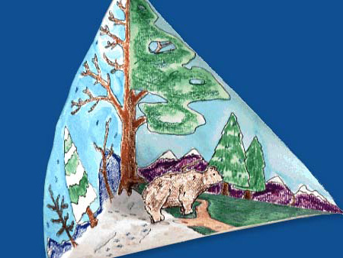
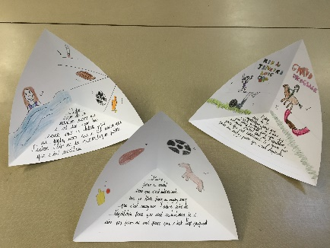
You are going to produce a response to Climate Change, based on your own feelings, thoughts, opinions and stories.
What is my ‘climate story’?
A poem?
A campaign speech?
An artistic response?
A letter to planet earth?
A personal pledge to the environment?
Questions to consider:
How does climate change make me feel?
Why is the earth valuable?
Are any of the religious responses helpful?
Who inspires me?
How should I act?
Success Criteria - I can:
- Identify factors that have affected my view of the environment.
- Reflect on how I can tell my own story in relation to Climate Change.
Your response needs to take the form of a triarama
Key Terms
Story
Influences
Climate Change

